Slide 1
Status Report
2015. 11. 13
Nam Jong Woo

Slide 2
Action Item
Muon plots without each cut (N-1 cut)
pT, eta, dimuon mass
Include Ratio plot
M60to120

Slide 3
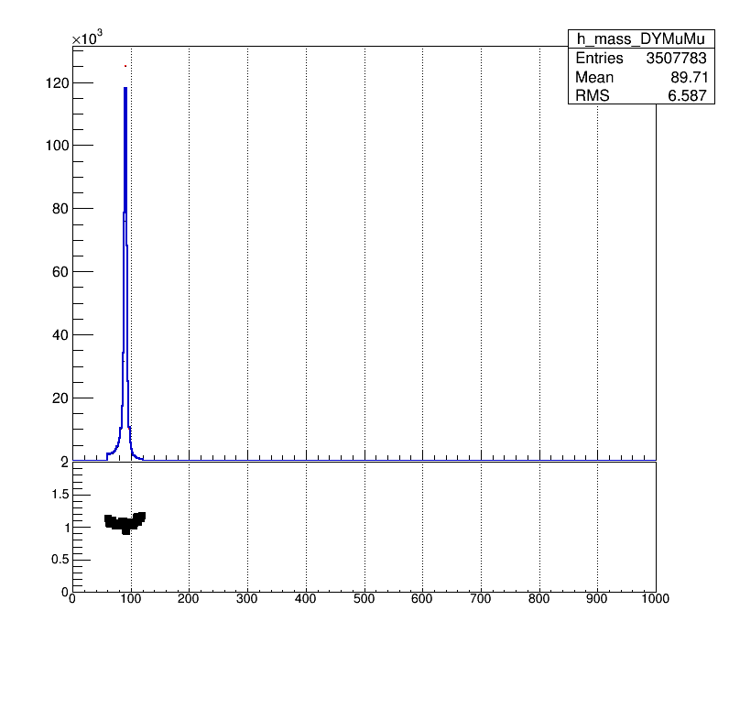
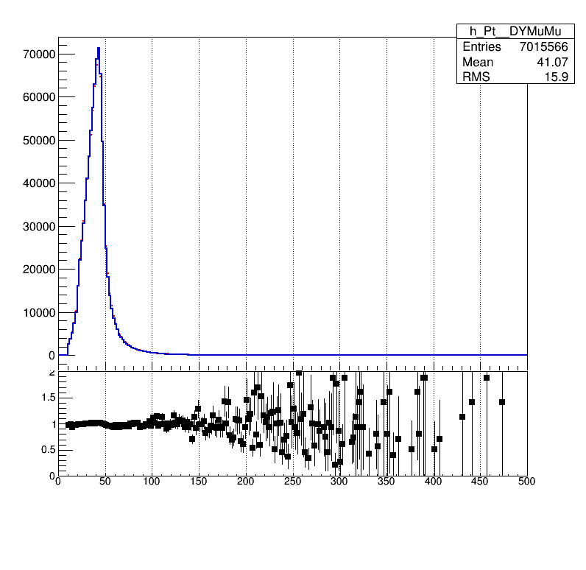
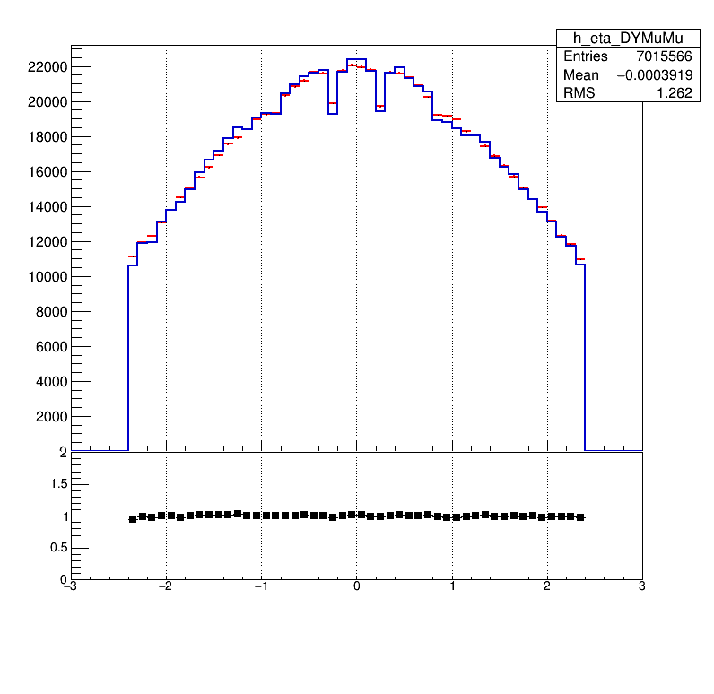
M60to120 TightMuon (All Cut Applied)
mass
pT
eta

Slide 4
Exclude Each Cut
isGLB == 1 | Reconstructed as a Global Muon
isPF == 1 | Particle Flow Muon the exclusive effect of this requirement is very small
chi2dof < 10 | χ2/ndof of the global-muon track fit < 10
muonHits > 0 | At least one muon chamber hit included in the global-muon track fit
nMatches > 1 | Muon segments in at least two muon stations This implies that the muon is also an arbitrated tracker muon
abs(dxyVTX) < 0.2 | Its tracker track has transverse impact parameter dxy < 2 mm w.r.t. the primary vertex
abs(dzVTX) < 0.5 | The longitudinal distance of the tracker track wrt. the primary vertex is dz < 5 mm
pixelHits > 0 | Number of pixel hits > 0
trackerLayers > 5 | Cut on number of tracker layers with hits >5
trkiso < 0.10 | (∑pT(TRK))/pT < 0.10

Slide 5
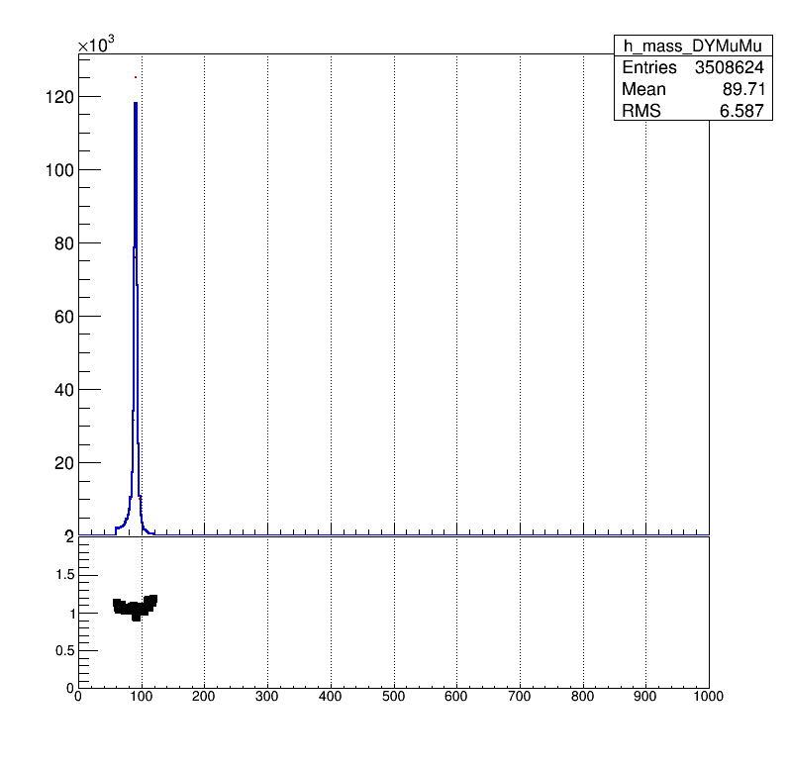
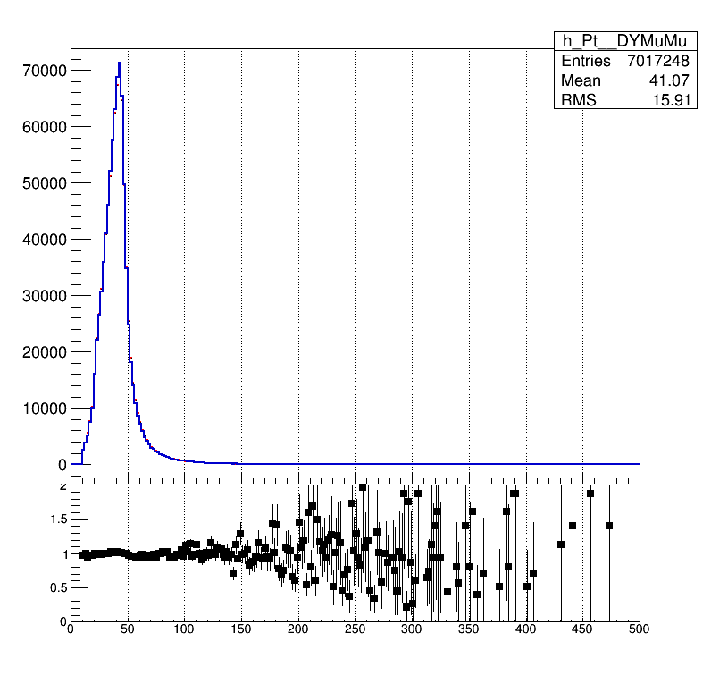
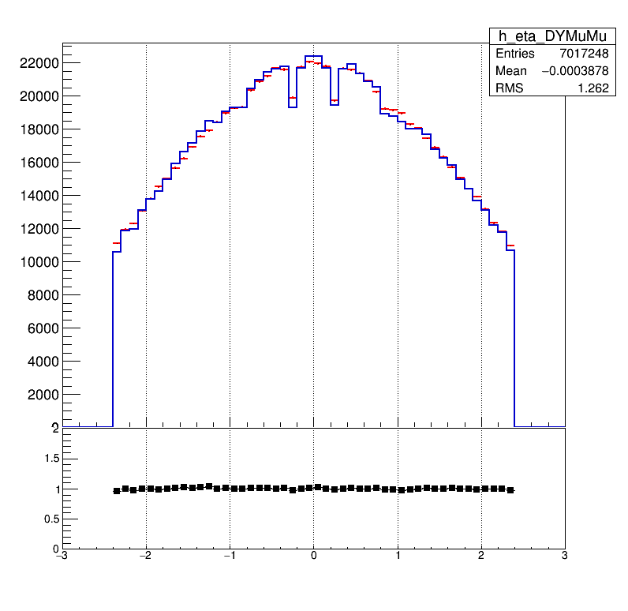
Without isGLB
mass
pT
eta

Slide 6

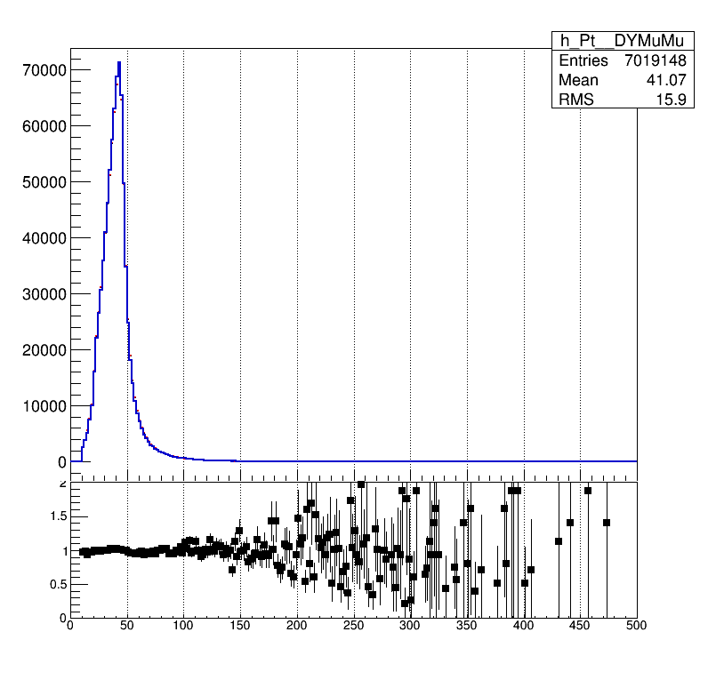
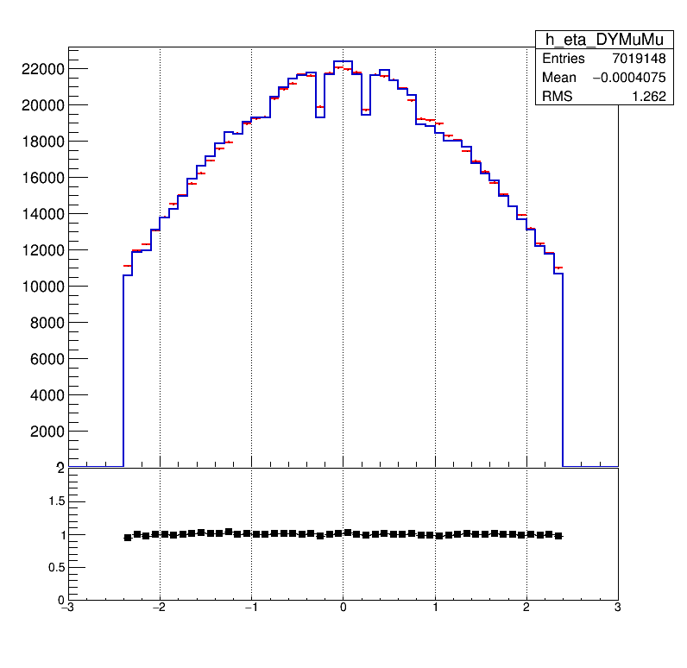
Without isPF
mass
pT
eta

Slide 7
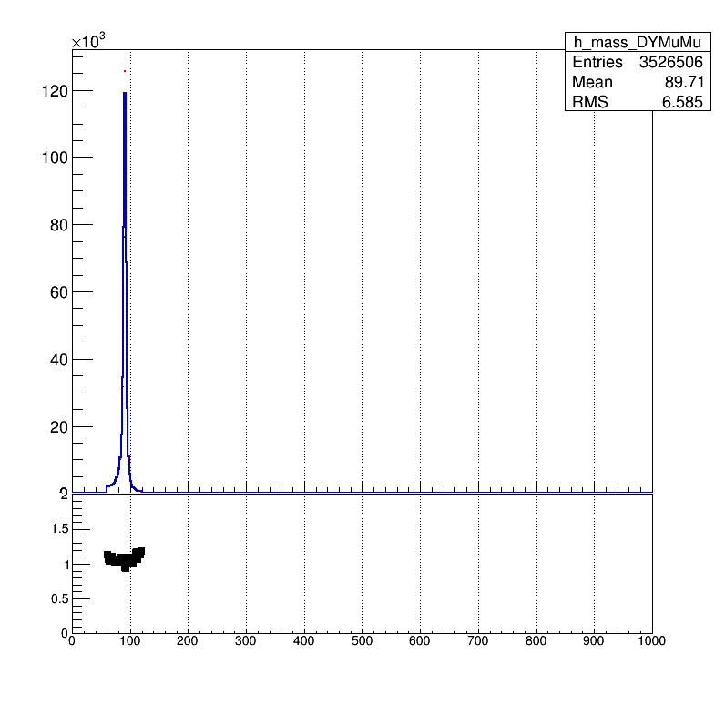
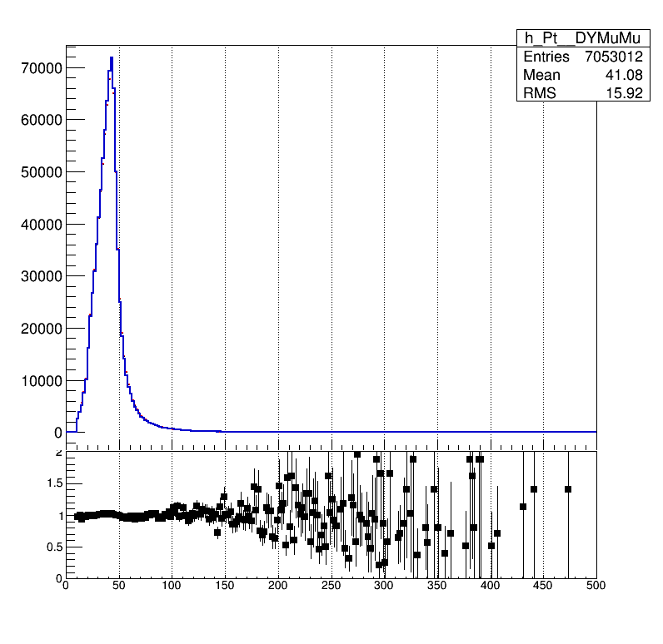
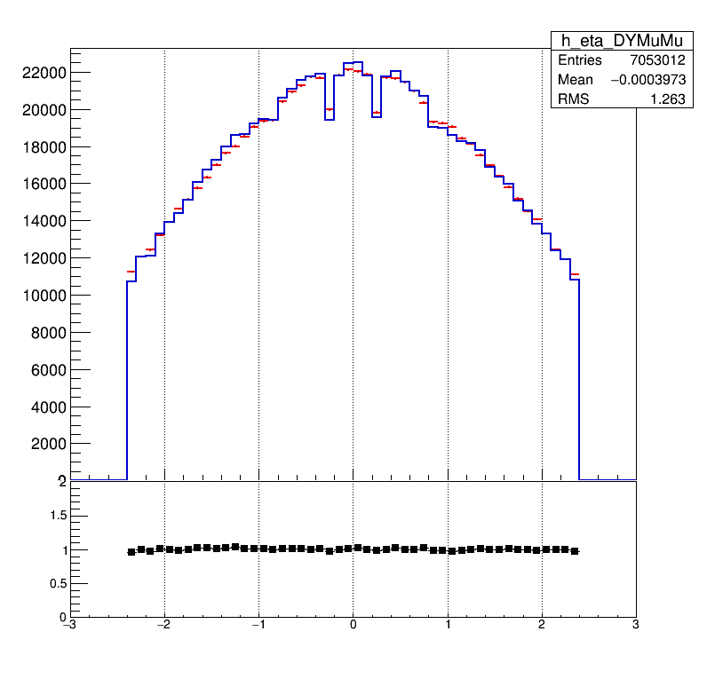
Without chi2dof
mass
pT
eta

Slide 8

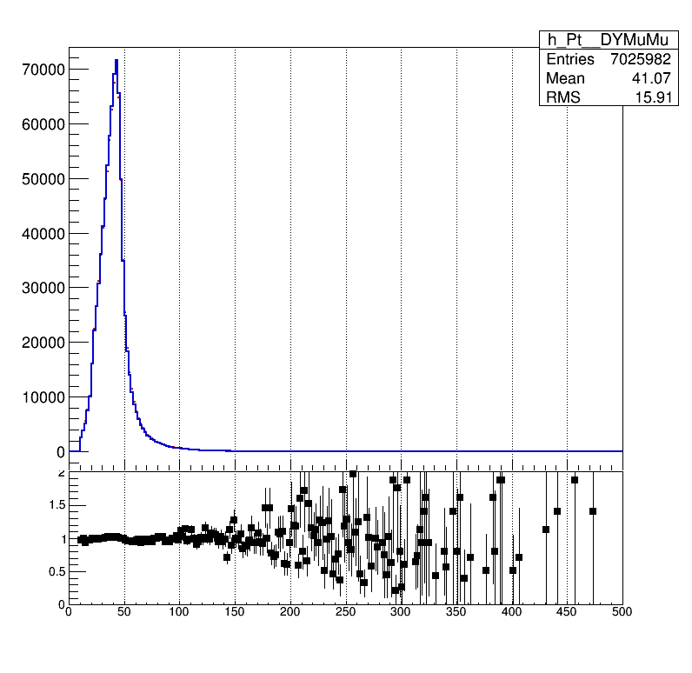
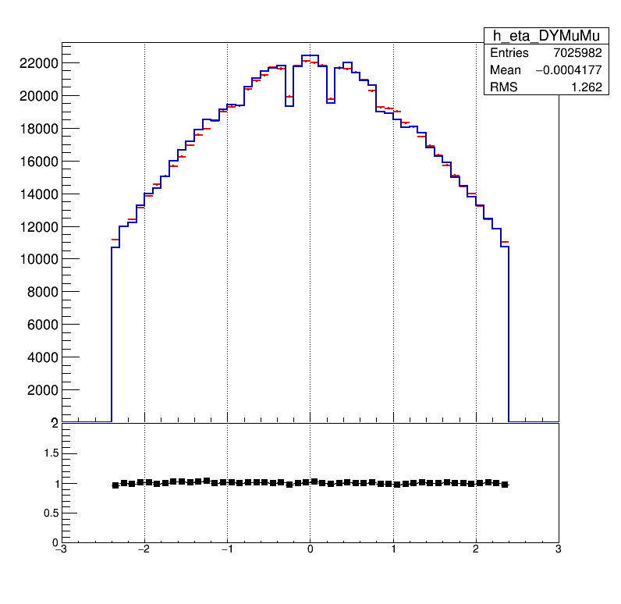
Without muonHits
mass
pT
eta

Slide 9


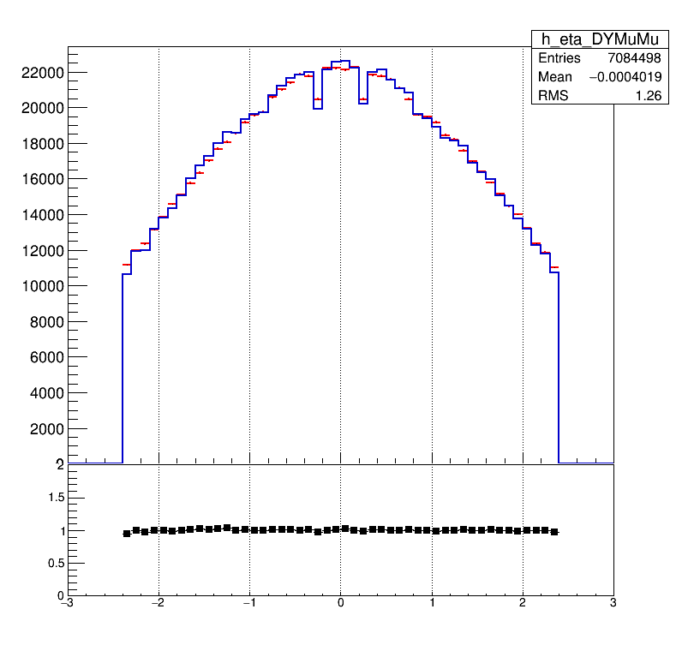
Without nMatches
mass
pT
eta

Slide 10


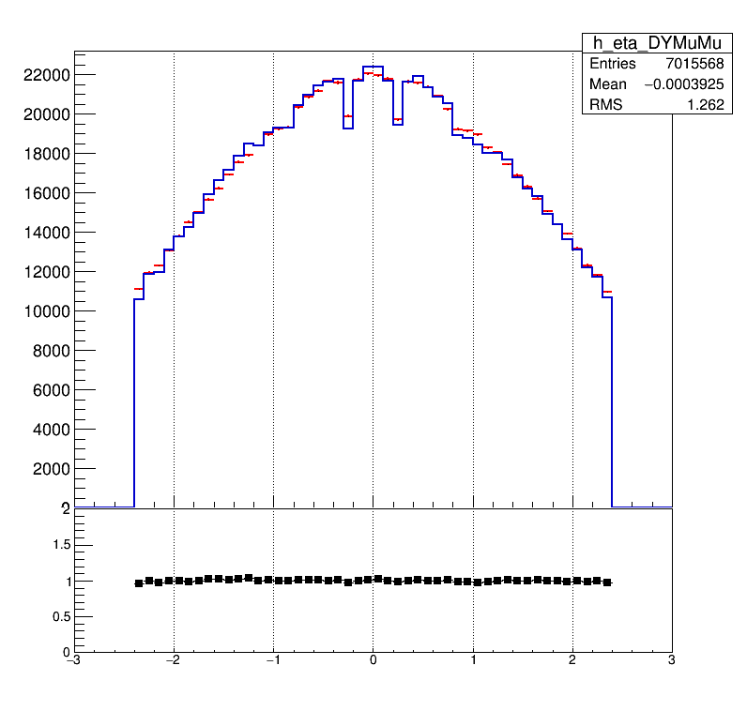
Without dxyVTX
mass
pT
eta

Slide 11
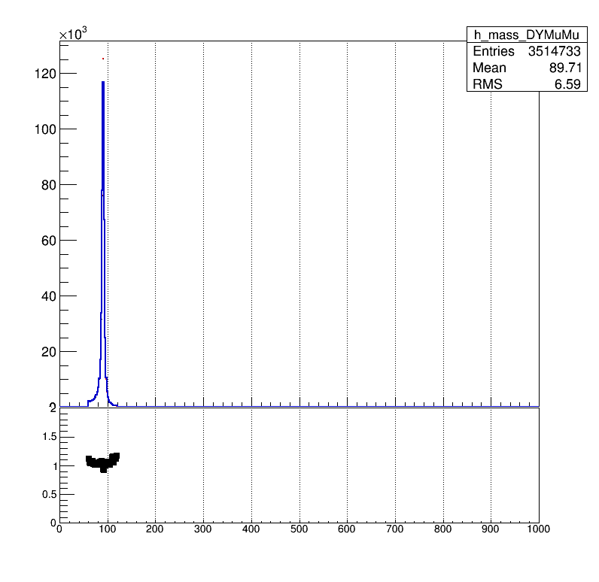
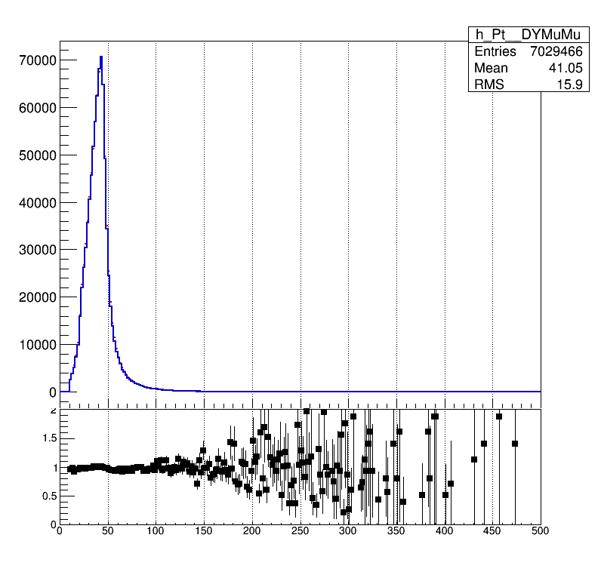
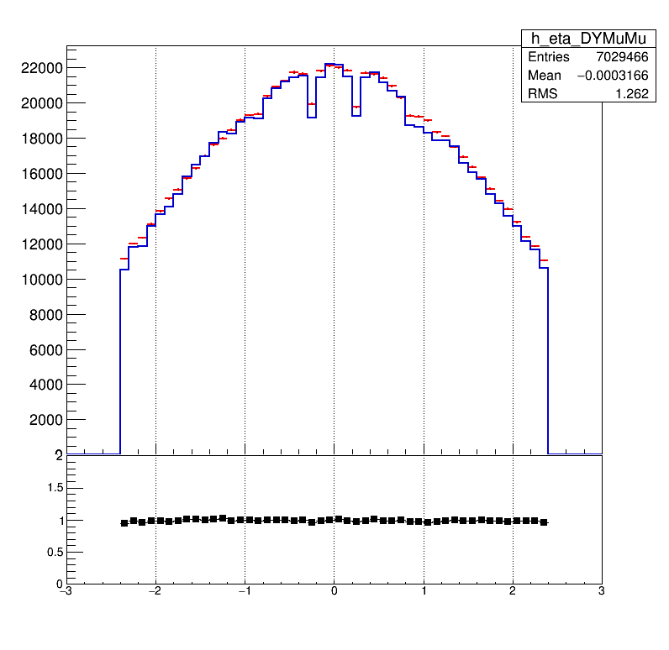
Without dzVTX
mass
pT
eta

Slide 12


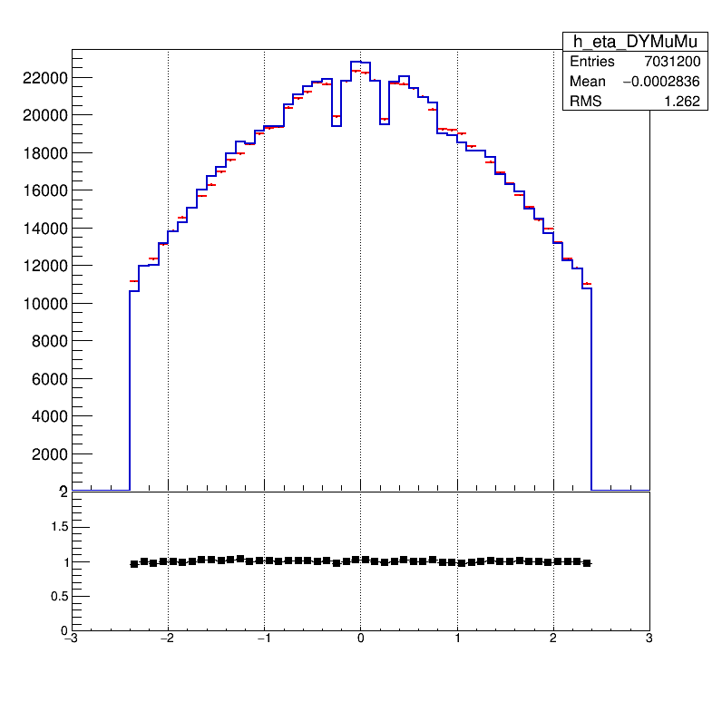
Without pixelHits
mass
pT
eta

Slide 13



Without trackerLayers
mass
pT
eta

Slide 14
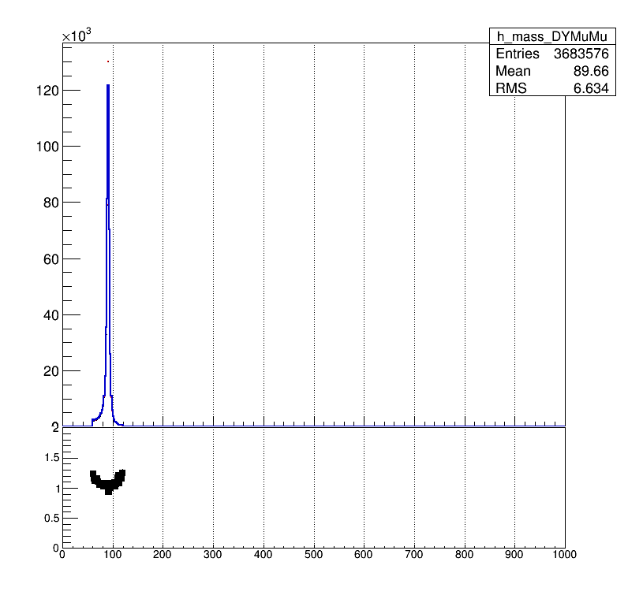
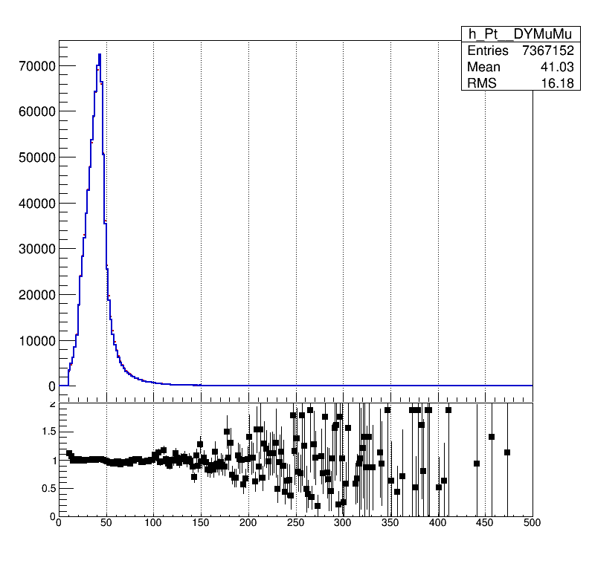
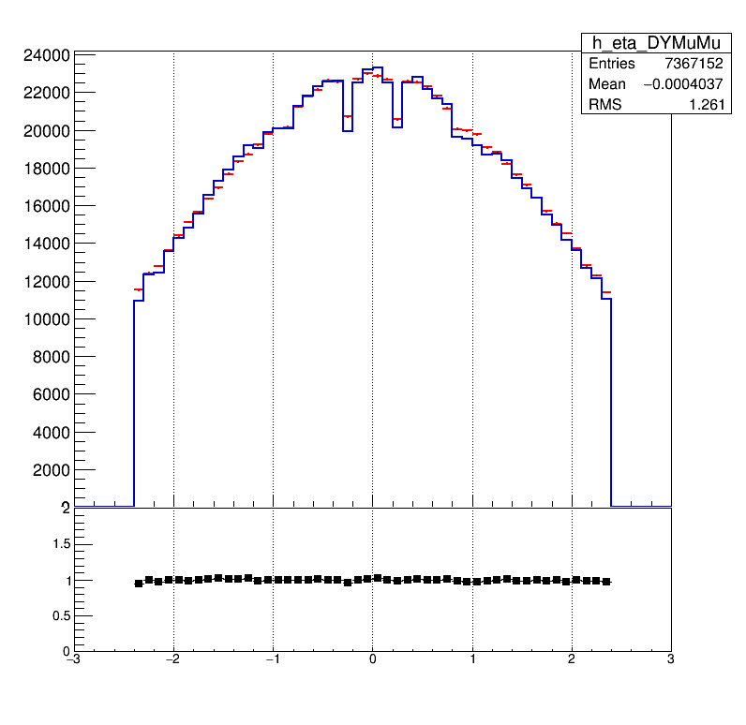
Without trkiso
mass
pT
eta

